Slide 1
SQRT decomposition

Slide 2
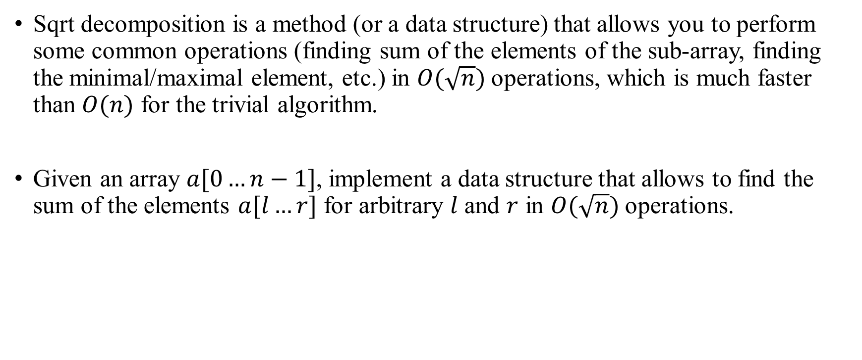
SQRT decomposition
Sqrt decomposition is a method (or a data structure) that allows you to perform some common operations (finding sum of the elements of the sub-array, finding the minimal/maximal element, etc.) in $O(\sqrt{n})$operations, which is much faster than $O(n)$ for the trivial algorithm.
Given an array $a[0…n−1]$, implement a data structure that allows to find the sum of the elements $a[l…r]$ for arbitrary $l$ and $r$ in $O(\sqrt{n})$operations.

Slide 3

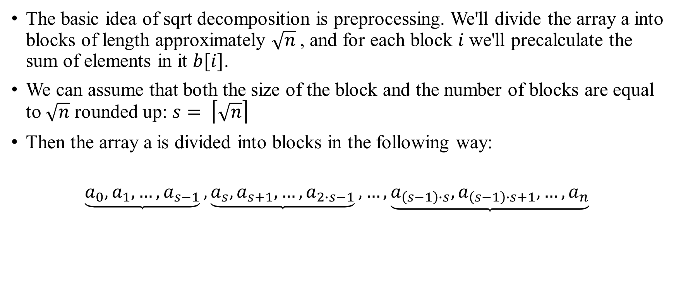


SQRT decomposition Description
The basic idea of sqrt decomposition is preprocessing. We'll divide the array a into blocks of length approximately $\sqrt{n}$, and for each block $i$ we'll precalculate the sum of elements in it $b[i]$.
We can assume that both the size of the block and the number of blocks are equal to $\sqrt{n}$ rounded up: $s= \left\lceil \sqrt{n}\right\rceil$
Then the array a is divided into blocks in the following way:
$$\underbrace{a_{0}, a_{1}, …, a_{s−1}}, \underbrace{a_{s}, a_{s+1}, …, a_{2∙s−1}}, …,\underbrace{a_{\left(s−1\right)∙s}, a_{\left(s−1\right)∙s+1}, …, a_{n}}$$
$$b_{1}$$
$$b_{2}$$
$$b_{s}$$

Slide 4
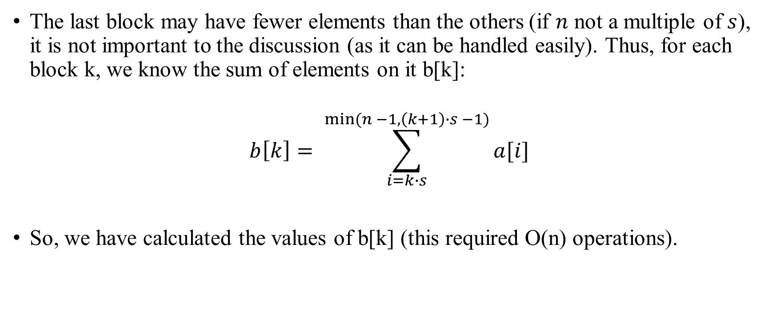
SQRT decomposition
The last block may have fewer elements than the others (if $n$ not a multiple of $s$), it is not important to the discussion (as it can be handled easily). Thus, for each block k, we know the sum of elements on it b[k]:
$$b\left[k\right]= \sum_{i=k∙s}^{min⁡(n −1, \left(k+1\right)∙s −1)}{a[i]}$$
So, we have calculated the values of b[k] (this required O(n) operations).

Slide 5
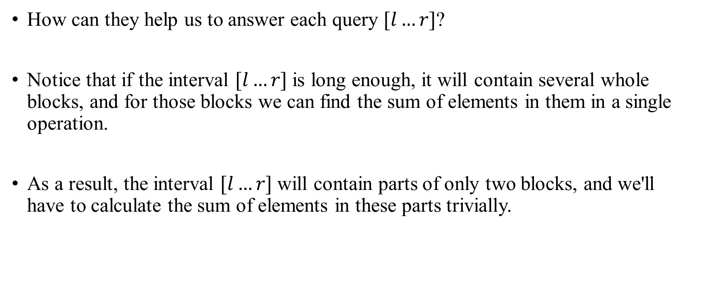
SQRT decomposition
How can they help us to answer each query $[l…r]$?
Notice that if the interval $[l…r]$is long enough, it will contain several whole blocks, and for those blocks we can find the sum of elements in them in a single operation.
As a result, the interval $[l…r]$will contain parts of only two blocks, and we'll have to calculate the sum of elements in these parts trivially.

Slide 6
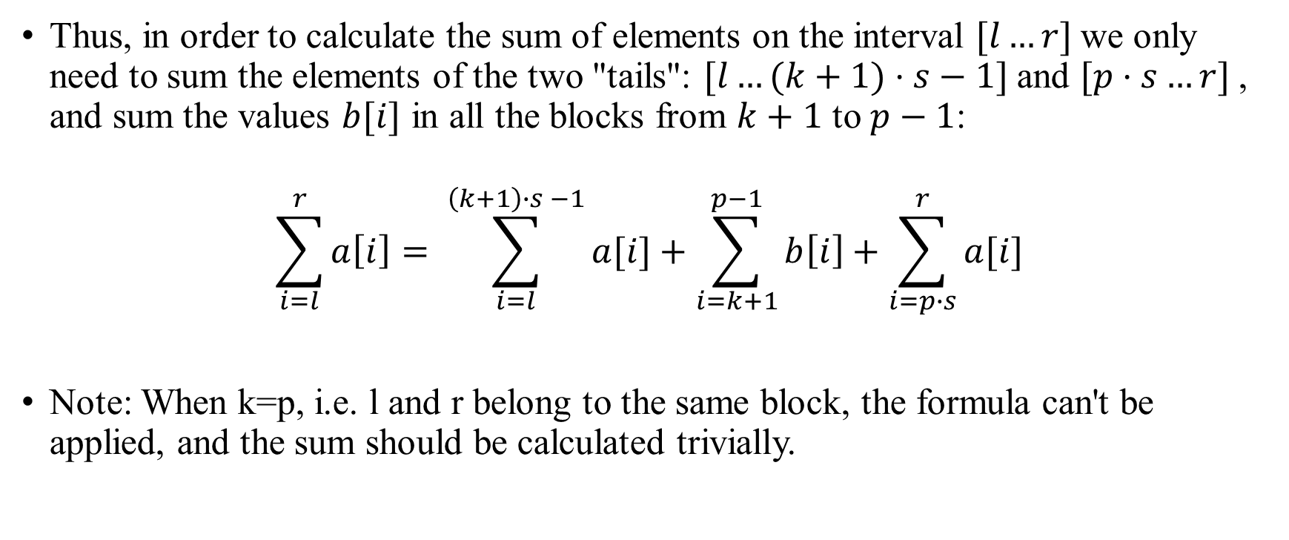
SQRT decomposition
Thus, in order to calculate the sum of elements on the interval $[l…r]$we only need to sum the elements of the two "tails": $[l…(k+1)⋅s−1]$and $[p⋅s…r]$, and sum the values $b[i]$ in all the blocks from $k+1$ to $p−1$:
$$\sum_{i=l}^{r}{a\left[i\right]}= \sum_{i=l}^{\left(k+1\right)∙s −1}{a[i]}+\sum_{i=k+1}^{p−1}{b\left[i\right]}+\sum_{i=p∙s}^{r}{a[i]}$$
Note: When k=p, i.e. l and r belong to the same block, the formula can't be applied, and the sum should be calculated trivially.

Slide 7
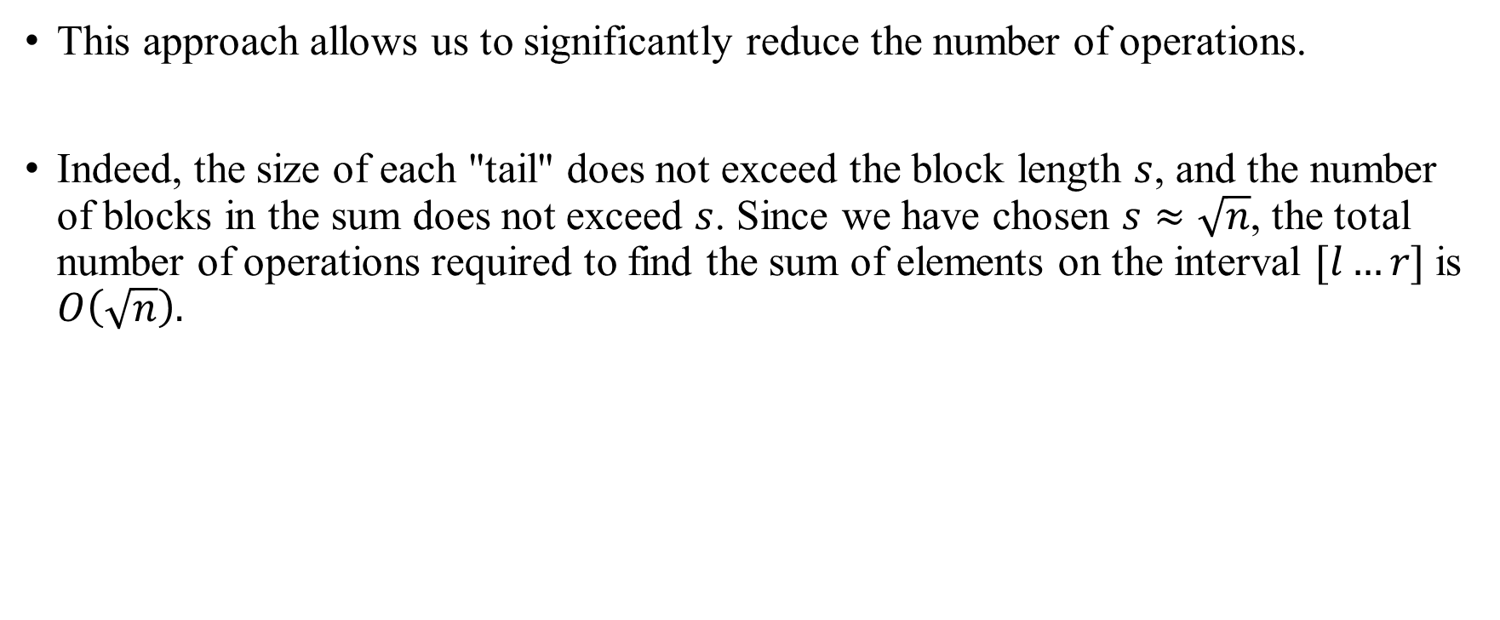
SQRT decomposition
This approach allows us to significantly reduce the number of operations.
Indeed, the size of each "tail" does not exceed the block length $s$, and the number of blocks in the sum does not exceed $s$. Since we have chosen $s≈\sqrt{n}$, the total number of operations required to find the sum of elements on the interval $[l…r]$is $O\left(\sqrt{n}\right).$

